Slide 1

Canover Insurance CO. Employee Benefit System
Joey Muzzo, Brian West, Trevor Wolfe, Jordan Sharpe, Andre magalhaes, Antonio Maldonado

Slide 2
Employee Benefit System Case Study
In the first week we were introduced to The Canover Insurance Company Inc. They service nearly 10 million customers nationwide. They are looking to reengineer all systems related to human resources. The plan is to develop a new Employee Benefits System that will track employee information, time and attendance, and payroll. The goal of the Employee Benefits System is to provide a common set of automated, integrated, platform-independent system solutions for Human Resources. The new Employee Benefits System should provide the capability for each employee to maintain his or her own information regarding address and telephone number changes, beneficiary changes, United Way deductions, and Savings Bond deductions. The EBS system will also track employee insurance information, requiring them to have some type of insurance. Canover Insurance wants to offer its employee’s insurance if they do not already have coverage.

Slide 3
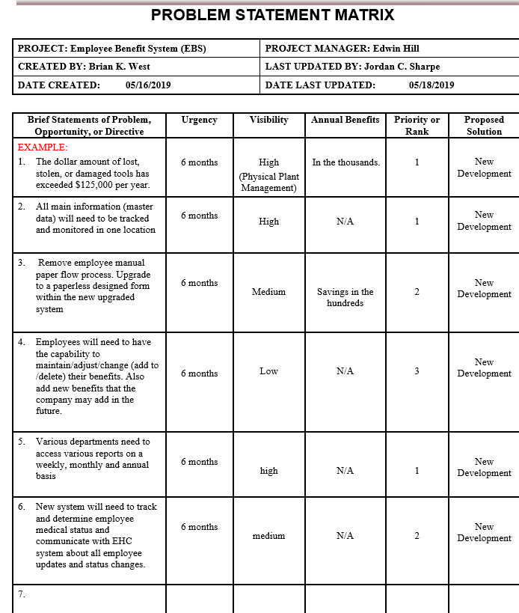
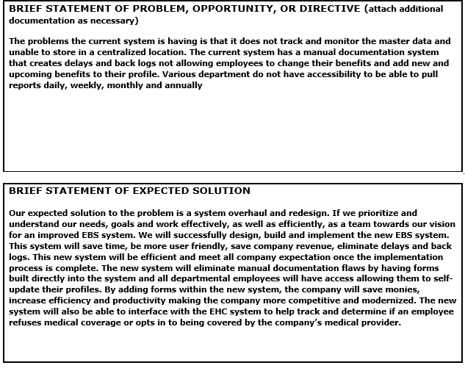
Problem Analysis

Slide 4
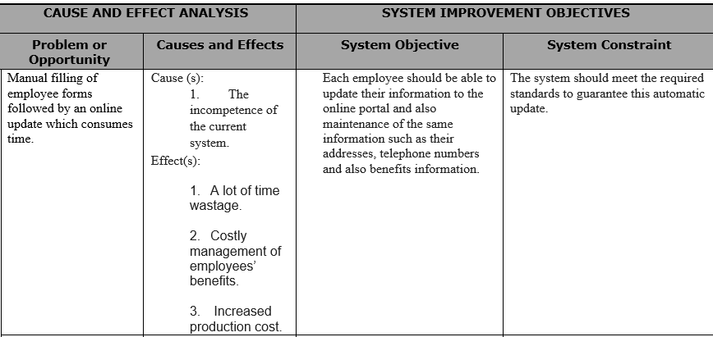
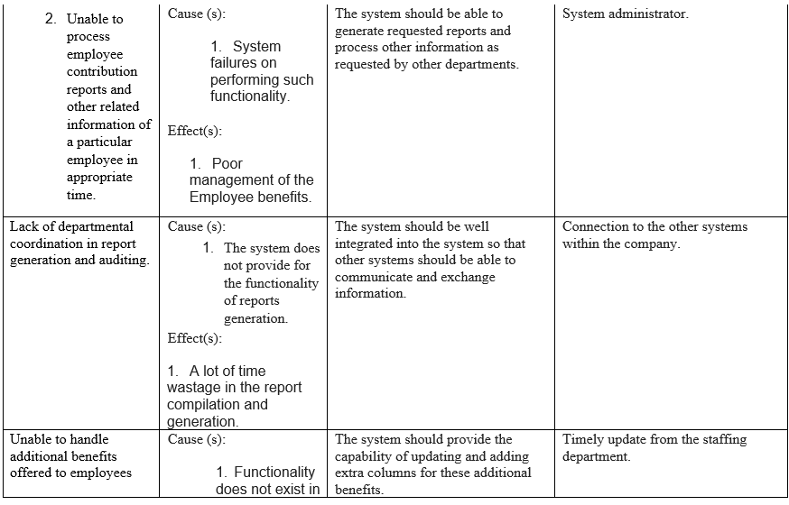
Cause and Effect Analysis

Slide 5
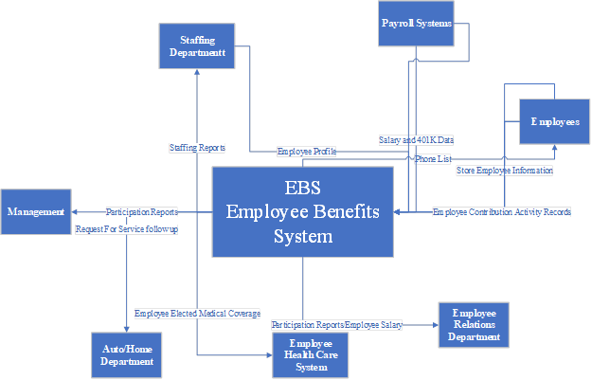
Context Data Flow Diagram

Slide 6
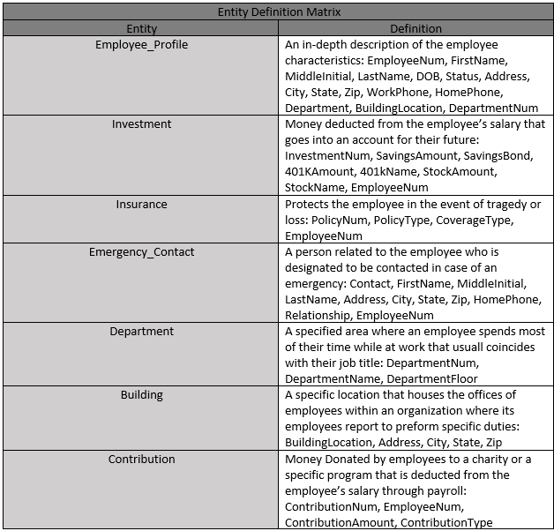
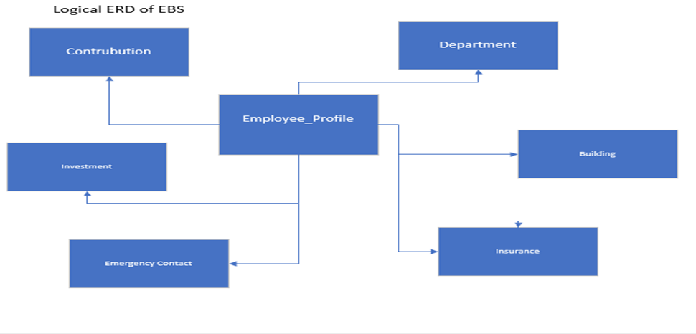
Entity Definition Matrix & Logical ERD

Slide 7

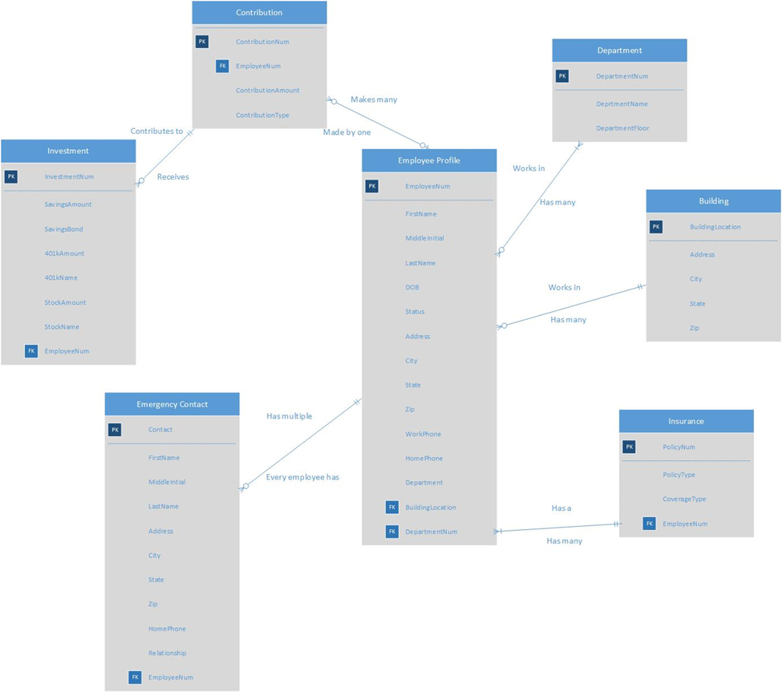
Context Data Model

Slide 8
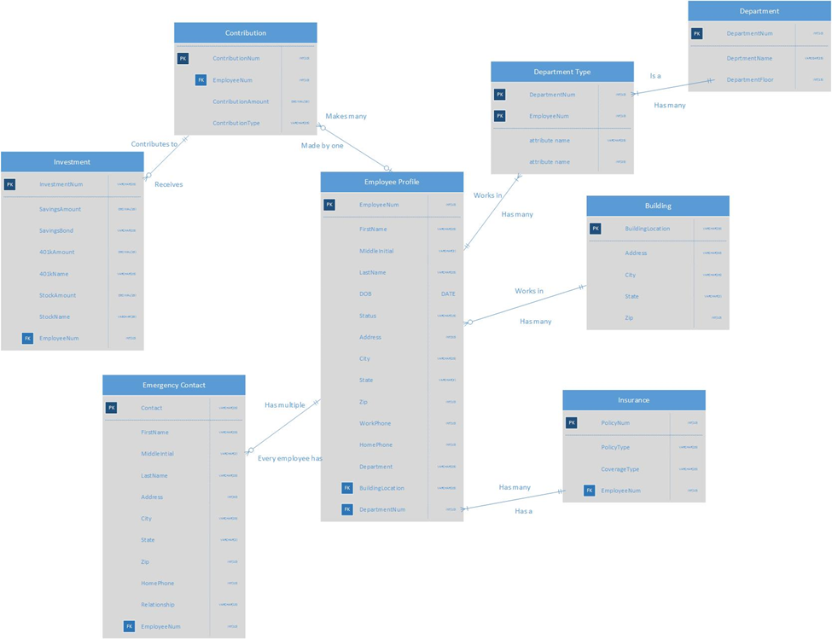
Fully Attributed Physical ERD

Slide 9
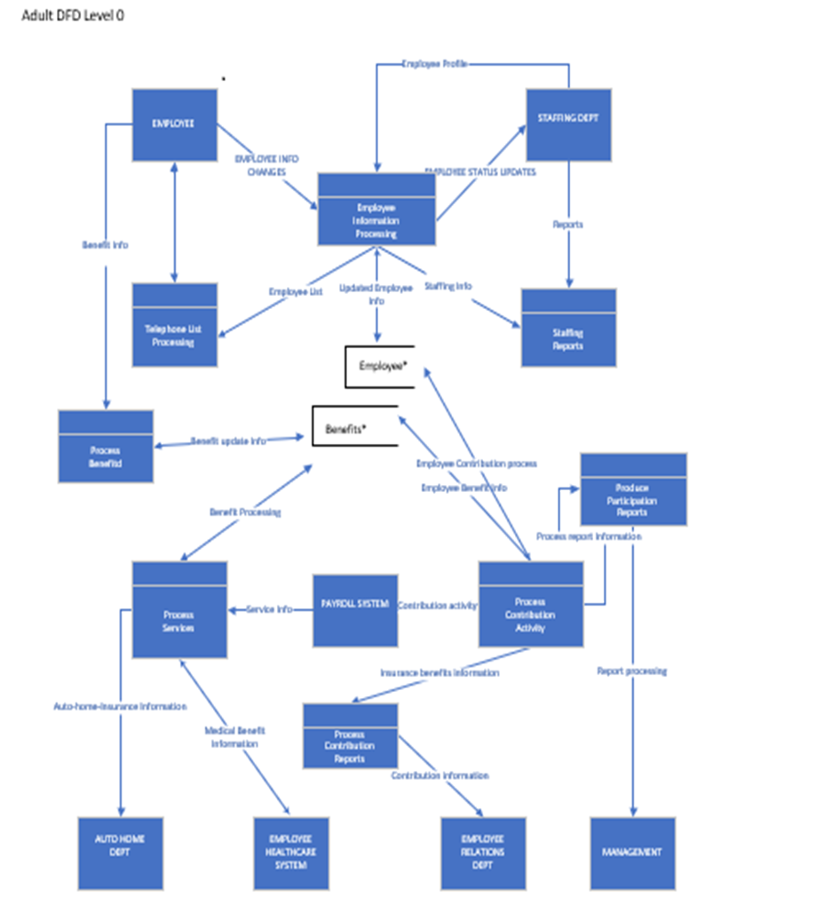
Adult DFD level 0

Slide 10
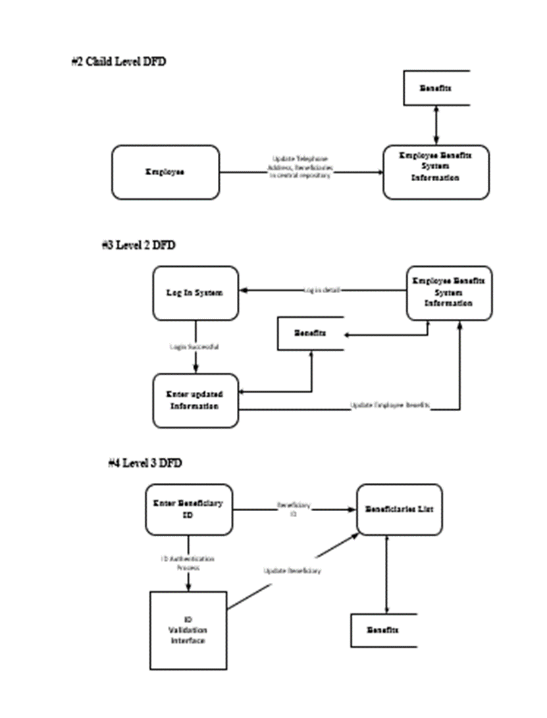
Child DFD level 2 & 3

Slide 11
Structured English for 3rd level DFD
#5 Structured English Procedure For 3rd Level DFD
Pseudocode for #4 Level 3 DFD
Enter the Beneficiary_ID
If
Beneficiary_Id = Beneficiary_Id does not meet requirements
Print “Please Re-Enter ID”
Else
Update Employee information
Return “Update Successful”
End if

Slide 12
Conclusion
With all of the models presented we feel confident in our ability to produce a new Employee Benefit System application for The Cavoner Insurance Company Inc. The application will meet all the requirements set by the company. The requirements by Canover were implemented in the designs for the EBS system. This system will help to eliminate the extensive manual effort in which Human Resource administrators fill out forms and input the data. It will reduce errors and delays caused by the old methods of data input.

